Slide 1
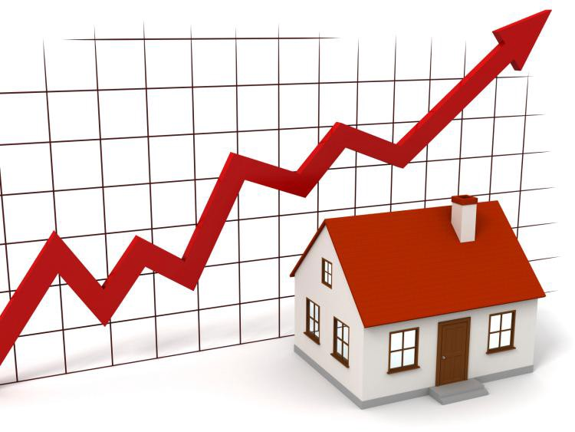
Machine Learning Foundation- Predicting House Prices
Shikha Gupta, PhD

Slide 2
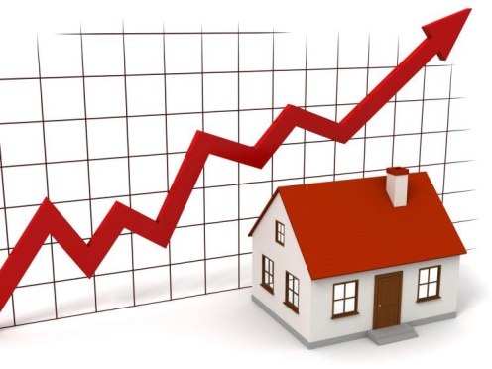
Problem Statement
To build a Machine learning model using the provided data to accurately predict house prices, based on the known features

Slide 3

Data Description
House prices dataset consisted of 81 variables related to houses with data for 1460 houses along with their Sale Prices
(38 numerical and 43 categorical)
However, 6,965 (5.9%) values were missing
Alley, MiscFeature and PoolQC had over 90% values missing and Fence had 81% values missing
3SsnPorch, ScreenPorch, PoolArea,LowQualFinSF and MiscVal had over 90% values as zeros and BsmtFinSF2 and Enclosed Porch had over 85% values as zero

Slide 4
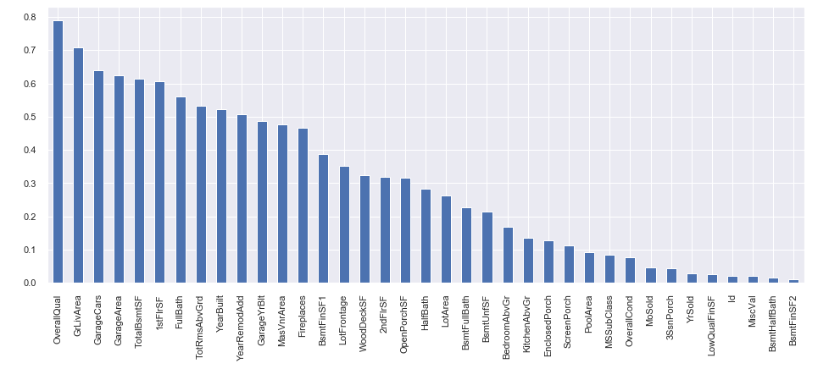
Exploring Data via Correlation Analysis with Sale Price

Slide 5
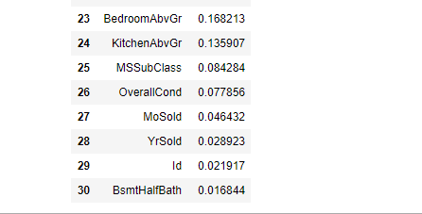
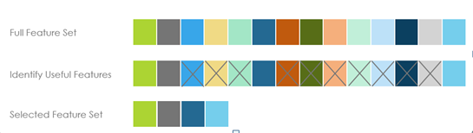
Feature Selection – Part1
Based on the correlation analysis, there were 8 variables which had a low correlation with Sale Price – correlation coefficient of less than 0.2 – hence removed these features

Slide 6
Feature Selection – Part 1(cont…)
Since there were too many variables, to build a stable model, it was important to remove the features which were adding noise. Hence removed features with more than 80% missing values.
Also removed columns where more than 80% values were zero, since most of the houses in the dataset do not have these features (hence they are zero for more than 80% observations)

Slide 7
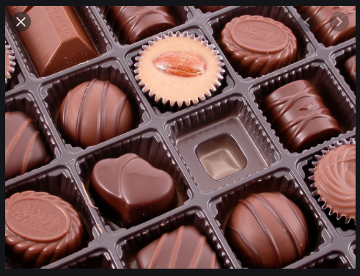
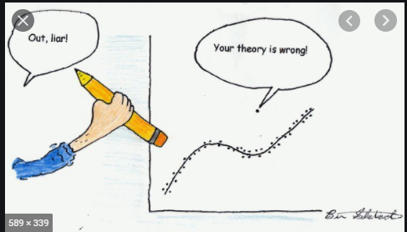
Missing Value and Outlier Treatment
After, Feature Selection, the dataset had 62 features (instead of 81) – 23 numerical and 39 categorical
The missing values were analysed and classified. Missing values were filled based on the their class:
If the values were missing ‘Not at Random’ then they were filled based on the information obtained from related columns
If the values were “Missing Completely At Random’, then they were imputed using KNN imputer
There were many columns which had outliers
Both LOF and Isolation Forest were compared for removal of outliers and Isolation forest performed better
Remaining Observations : 1206

Slide 8
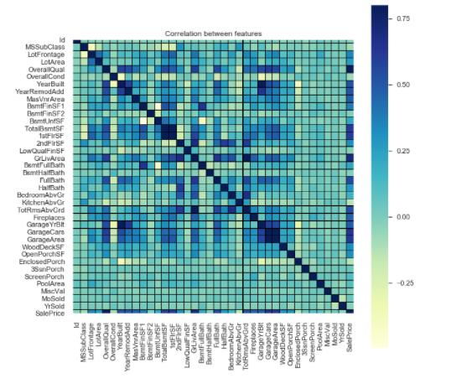
Linear Regression Models
After, Feature Selection, missing value treatment and outlier removal, the dataset was used to build various linear regression models to predict House prices
Model 1 : Cleaned data set with 62 features and 1206 Obs
Model 2 : Dataset (with 62 features) was standardized
Model 3 : Combined related features to remove multicolinearity (Feature Engineering)
Model 4 : Standardized all Features
including Engineered
Features

Slide 9
Model Evaluation

Slide 10
Improving Model 2 by Feature Selection
Because of a large number of features there was still multicolinearity in the dataset.
To reduce multicolinearity, removed 10 features from standardized dataset, where correlation co efficient was greater than 0.6 (Model 5)
Features reaming: 52
Also removed 14 features where correlation with Sale Price was low (Corr Coeff was less than 0.1) (Model 6)
Features remaining: 38

Slide 11
Model 2 is the Best Model
As shown in the above plot, Model 2 had the lowest RMSE values and hence was the best model

Slide 12
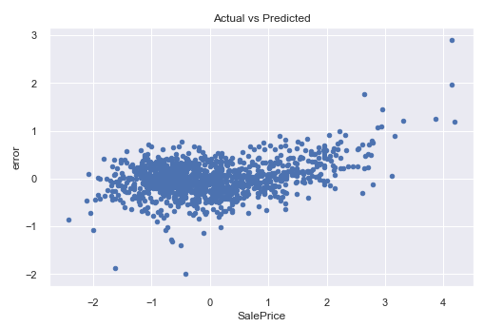
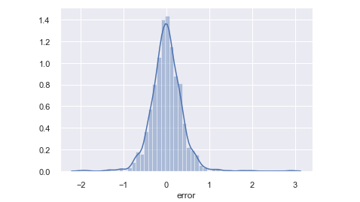
Heteroscedasticity in Model 2
As indicated by the above plots, Model 2 had a normal distribution of error, though there was still some variance.
All other models had similar levels of heteroscedasticity

Slide 13

Final Conclusions
The best Model out of the 6 tested models was Model 2 (based on RMSE values)
The Model takes into account 62 features instead of 81 (initial dataset)
Feature Engineering tried here deteriorated the model and also increased the heteroscedasticity significantly (Model 3)
Standardisation did not improve the model much (Model 4)
Feature Selection (Removing correlated features and features having low correlation with Sale Price (Corr Coeff < 0.1)) increased the RMSE values, though only slightly but did not increase the heteroscedasticity (Models 5 & 6)
There is room for improving the model by trying several things:
Adding the Features that were removed in the beginning
Trying other ways of Feature Engineering – Hyperparameter Tuning
Trying different combination of engineered features
Remove Multicolinearlity using other methods like PCA

